Slide 1
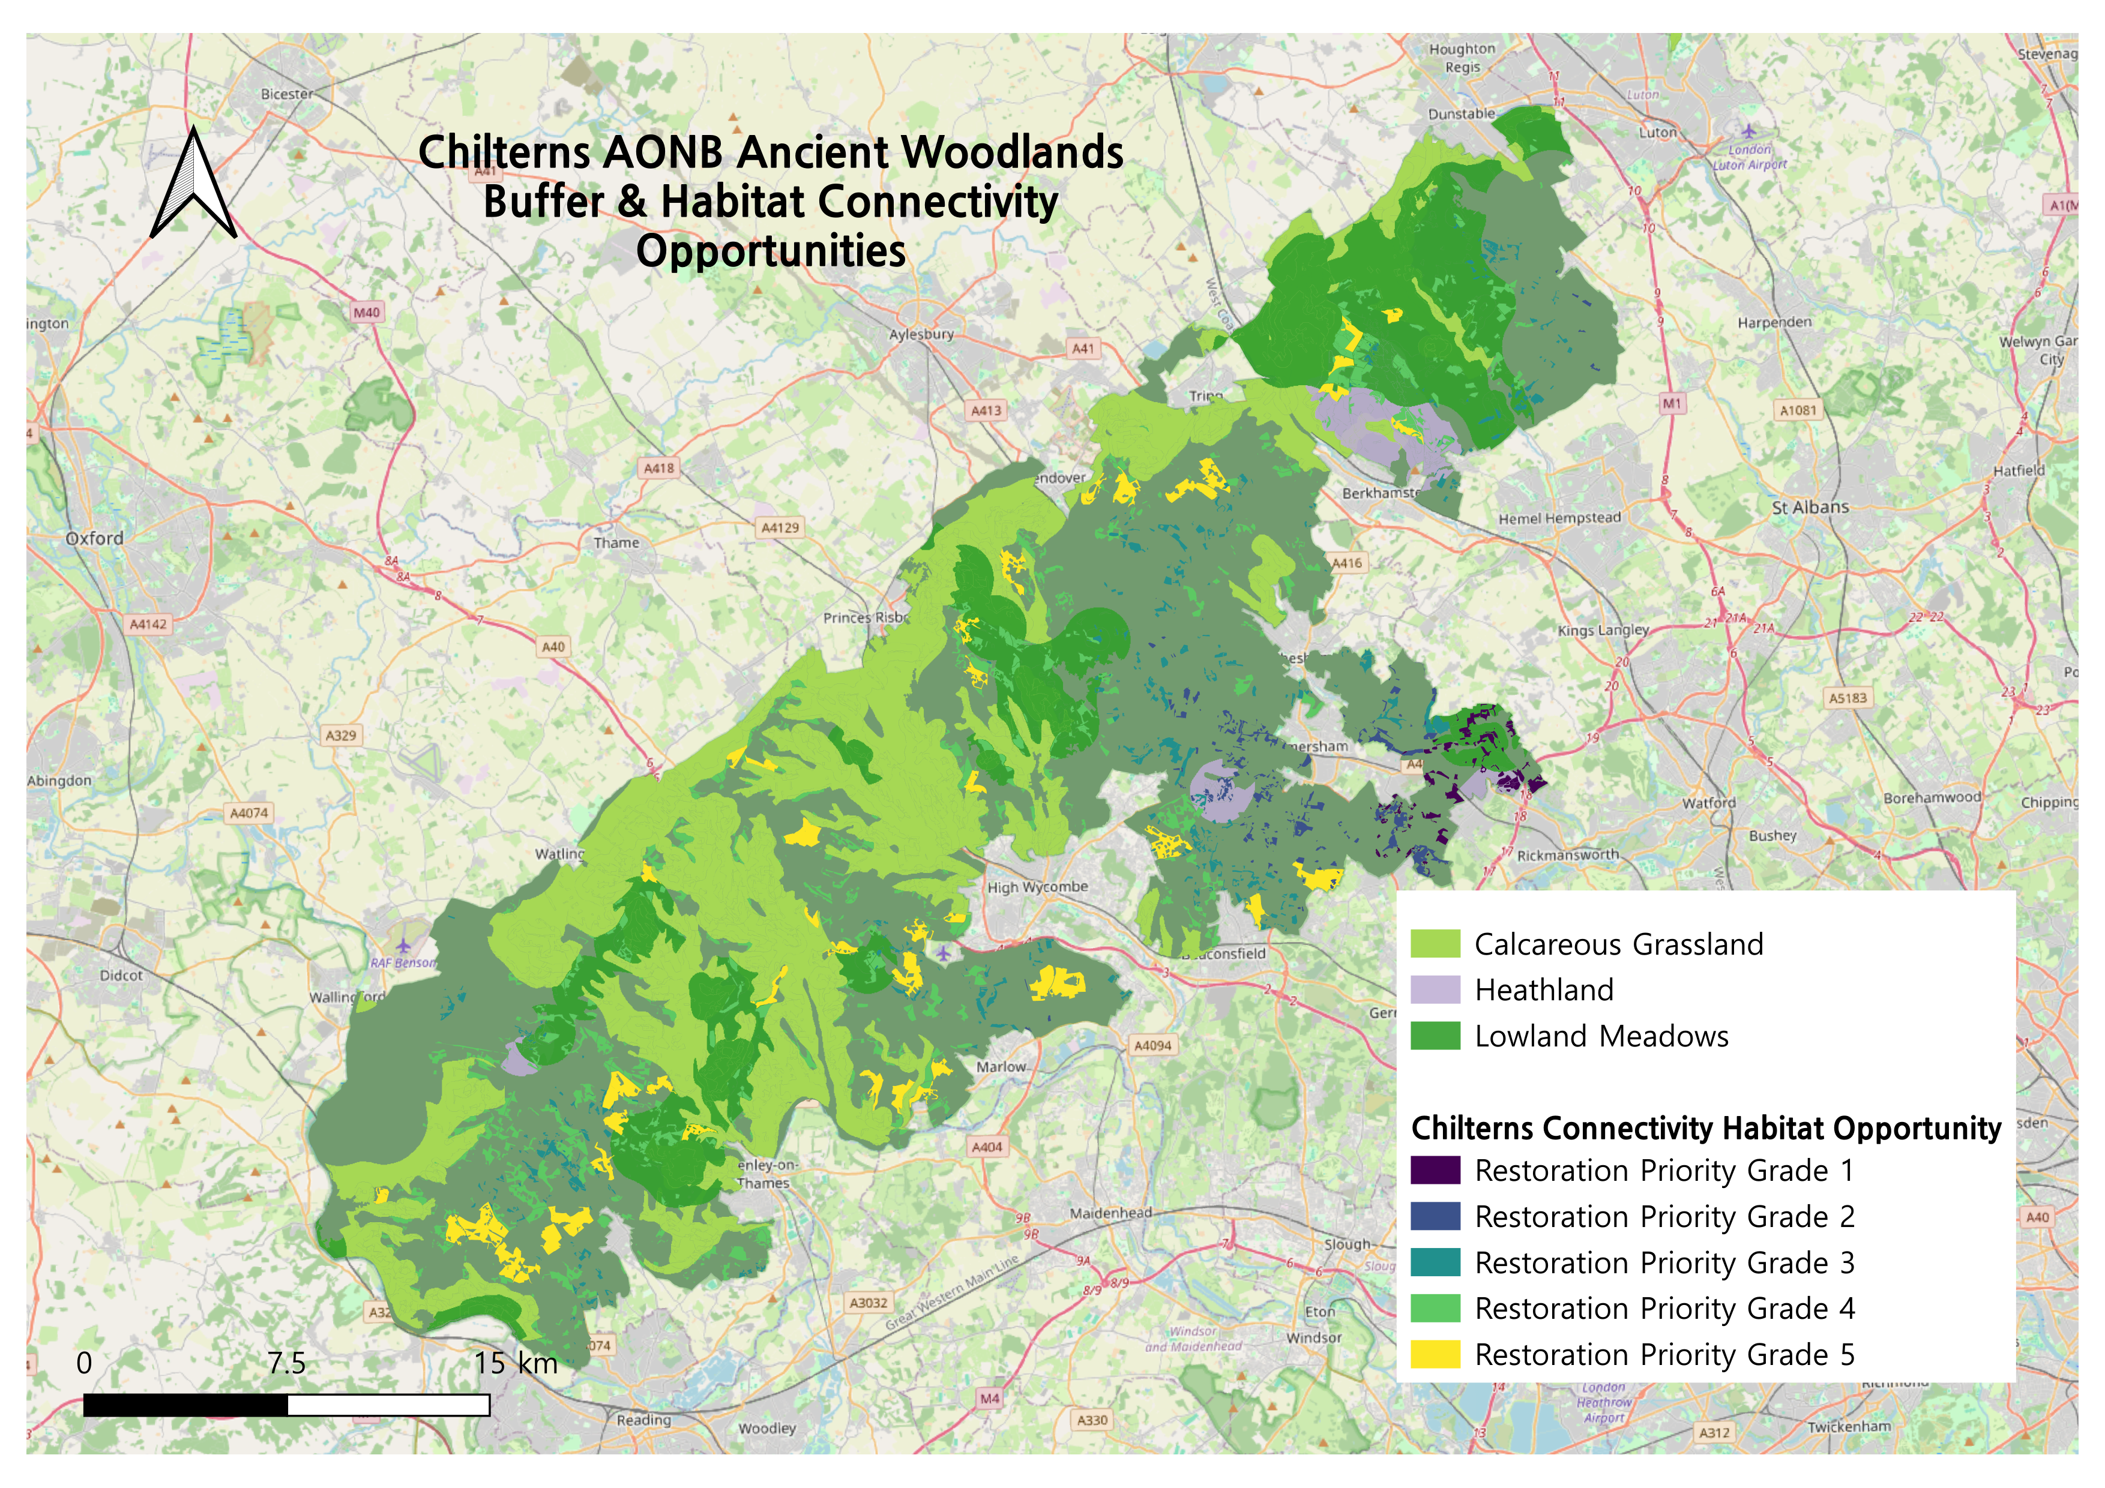
UK National Parks Habitat connectivity opportunity Project

Slide 2
The aim of this project was to locate, within the habitats that are distinct to each of the 10 National Parks of the UK, patches that have potential for connectivity with Ancient Woodlands and other habitats and thus function as center for habitat restoration and expansion. Ancient Woodlands can function as basis for habitat retention and restoration because they are harbours of massive mycorrhizal fungi network, humic layer of soil and invertebrates. I located the areas of Ancient Woodlands in each park by clipping the UK Ancient Woodlands layer with the park boundaries, buffered them 250m, chose a different habitat type for each park that has distinct ecological significance for each park and clipped that as well, made subtraction of the buffered woodlands area and habitat layer, overlayed them with the Priority Habitat Inventory Layer to find candidates for places with high ecological value when restored, excluded road areas by using OS Open Roads Data and used centroids tool in the software to calculate the shortest path from the candidate patches to the already existing habitats, used the MCDA method to score it based on the distance and the area of the candidate patches and classified the symbology of the candidate patches according to the scoring. I first did this as a hobby project for a nature reserve called Chilterns AONB near my home, and the thought it would be a good portfolio material so fed the process to AI and got it to script the pipeline using Python in QGIS and automated it. The usage of 250m buffer was based on Lawton principle of creating “more, bigger, better and more joined up” habitats and I believe my project is inline with the quantification of BNG investment baseline. The following pages briefly explain the steps I undertook with images.

Slide 3
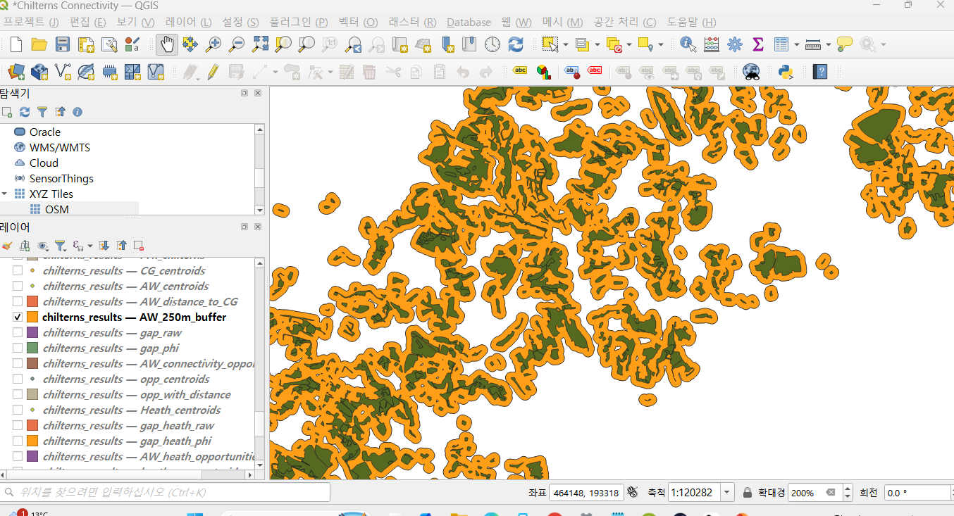
Baseline Anchoring: Ancient Woodland Extraction & 250m Ecological Buffer
Clipped Ancient Woodlands within the park boundary to establish the irreplaceable ecological anchor.
Applied a 250m buffer to define the critical ecotone zone for fungal network expansion and seed dispersal.

Slide 4
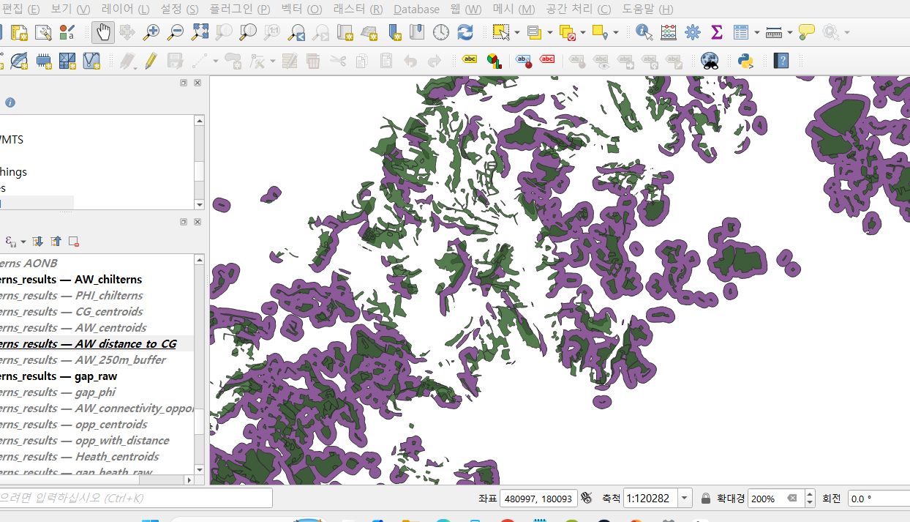
Target Habitat Selection & Gap Extraction
Selected a distinct, ecologically significant habitat for each park and clipped it to the boundary.
Subtracted the target habitat from the 250m woodland buffer to identify unoccupied fragmentation gaps.

Slide 5
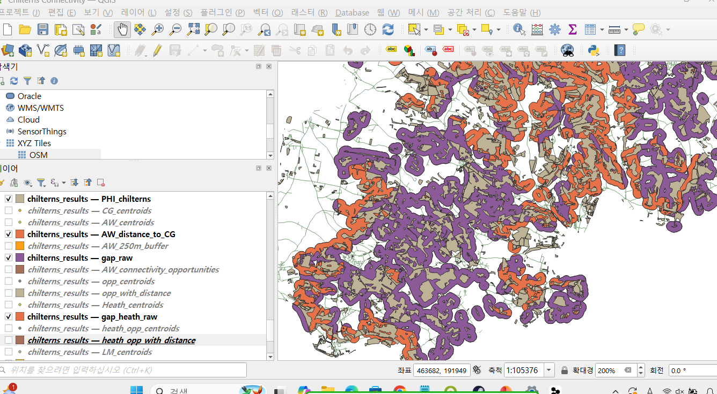
Priority Habitat Inventory (PHI) Overlay
Intersected the gap areas with the Priority Habitat Inventory to isolate land parcels with verified restoration potential.
Filtered out slivers and fragments smaller than 0.05 ha (500 sqm) to retain only viable patches.

Slide 6
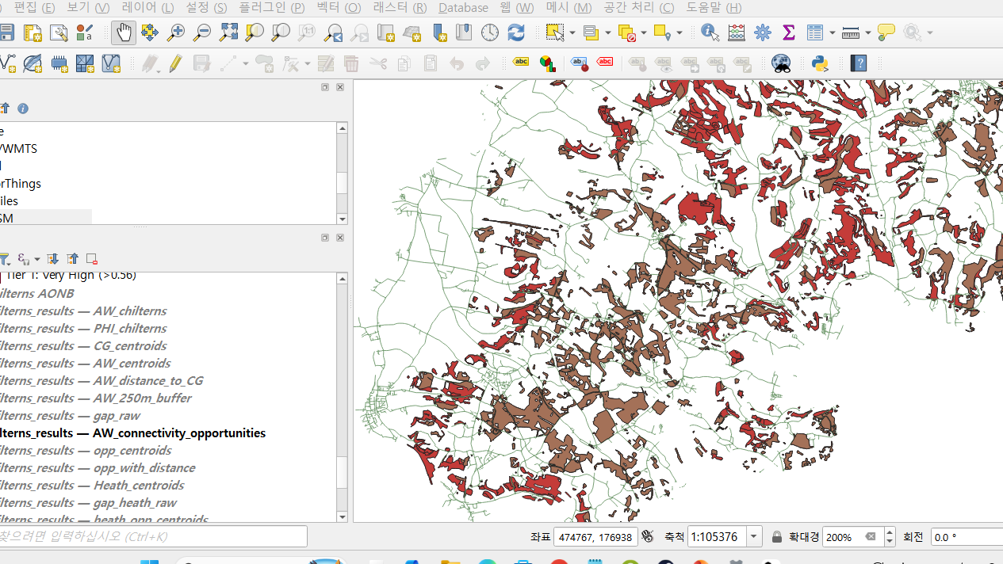
Road Barrier Exclusion
Extracted road networks within the park and created a 10m buffer to model dispersal barriers and roadkill risks.
Subtracted the road buffer from candidate patches to ensure physical corridor continuity.

Slide 7
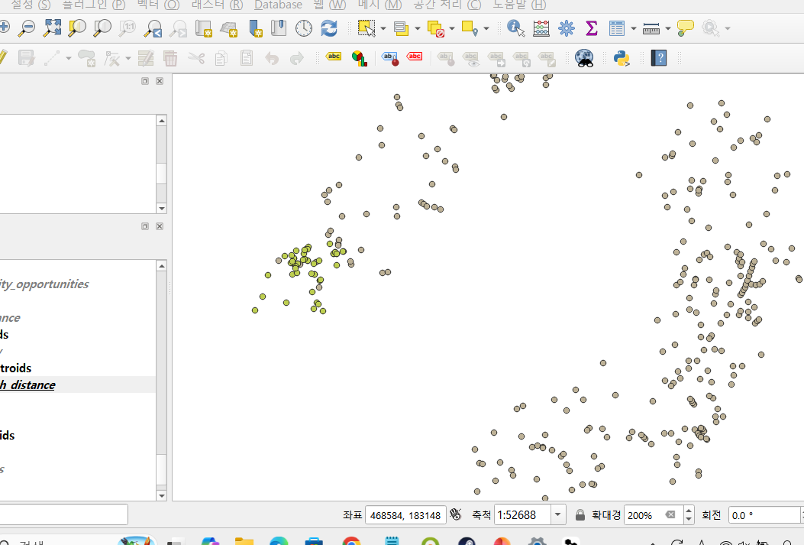
Centroid Distance & MCDA Scoring
Calculated the shortest distance from candidate patch centroids to existing habitat centroids.
Ranked patches using MCDA by weighting proximity (50%) and contiguous patch area (50%).

Slide 8
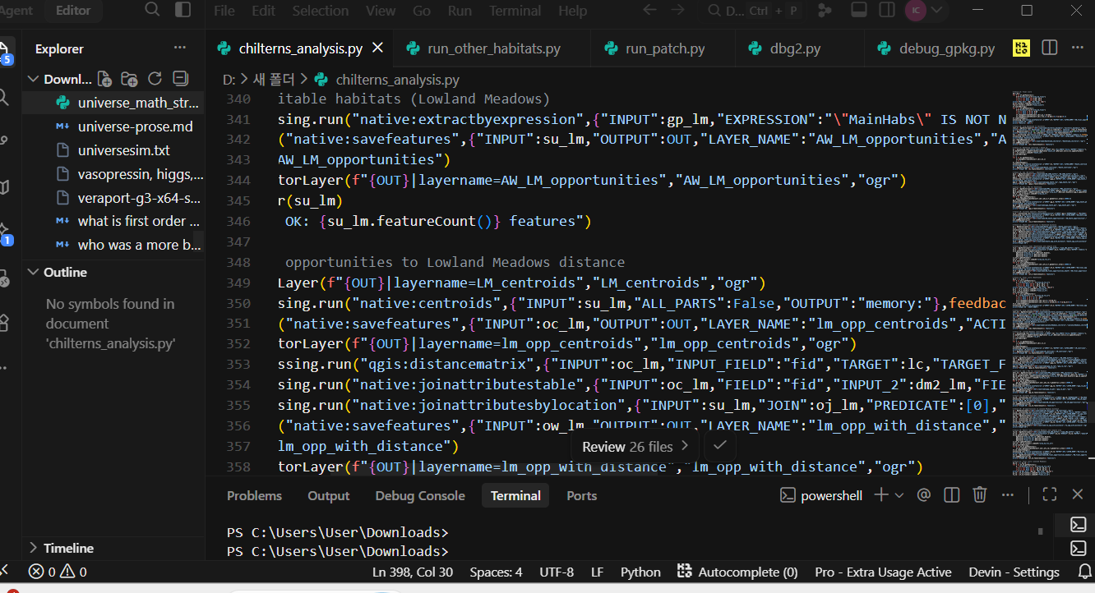
UKHab Cartography & Automation
Classified patches into 5 priority tiers (Tier 1–5) via Jenks Natural Breaks using official UKHab color codes.
Automated the entire pipeline in Python across all 10 National Parks to generate standardized, publication-ready layouts.

Slide 9
A Weighted Linear Combination (WLC) model was applied to balance ecological efficacy (proximity) and land investment scale (area):
Proximity Score = 1 - (d / d_{max}) (Higher for patches closer to existing habitat)
Area Score = Area / Area_{max} (Higher for larger contiguous patches)
Final Composite Score = (0.5 x {Proximity Score}) + (0.5 x {Area Score})

Slide 10
Data Sources Used
Natural England Ancient Woodland Inventory (England) & National Parks Boundaries
Natural England Habitat Networks (Individual England)
Natural England Priority Habitat Inventory (PHI) Full Dataset
Ordnance Survey (OS) Open Roads GB

Slide 11
Reference
Natural England - Habitat Network Mapping Guidance(PDF)
Malczewski (York University) - On the Use of Weighted Linear Combination Method in GIS (PDF)
Location Intelligence - Building Weighted Site Suitability Scores & MCDA

Slide 12
Thank You!

